Slide 1
DenseReg: Fully Convolutional Dense Shape Regression In-the-Wild
Rıza Alp Guler, George Trigeorgis, Epameinondas Antonakos,
Patrick Snape, Stefanos Zafeiriou, and Iasonas Kokkinos
CVPR 2017
2018-05-23
Yucheng Lu

Slide 2
Contents
Introduction
Related works
Proposed method
Experiment result

Slide 3
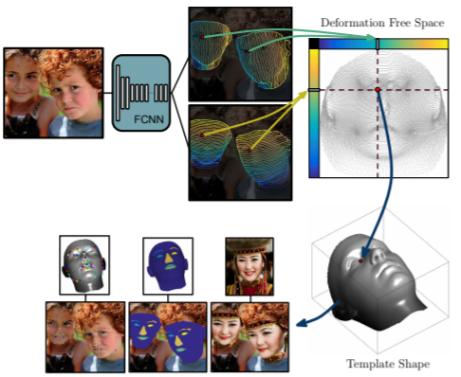
Introduction
This paper treats the task of learning a mapping from image to a dense template as a regression problem and proposes a fully convolutional network called DenseReg to achieve it.

Slide 4
Related works
CNN-based methods of non-planar object deformations often discard shape-related information by employing local “max-pooling” operations to achieve local translation invariant. There is no CNN that explicitly extract dense shape correspondences.
Other approaches that relay on Statistical Deformable Models (SDMs), such as Active Appearance Models (AAMs), 3D Morphable Models (3DMMs) explicitly recover dense correspondences between a deformation-free template and the observed image. However, they require time-demanding interactions, especially when the initial template is far from the solution.

Slide 5
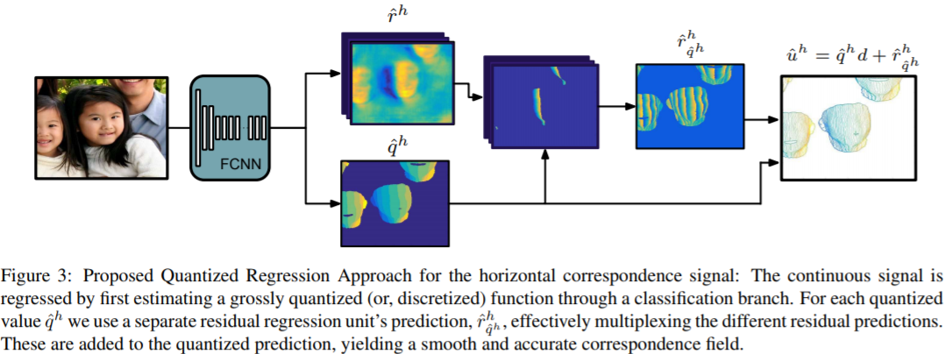
Proposed method
Basic flow chart: given an image, learn a series of parameters in a “canonical” face space that can deform the template to the target.

Slide 6
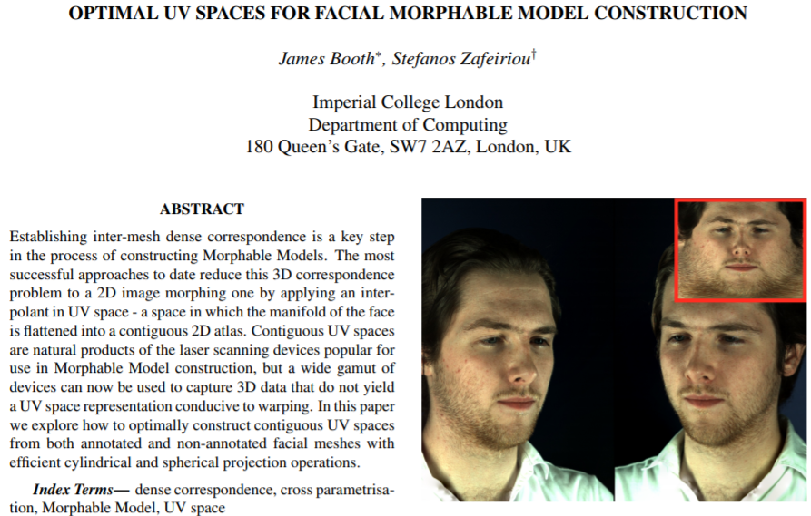
Proposed method
Obtaining the ground truth:
Assume a template mesh , we want a mapping that maps it to a canonical UV space:
Which can be obtained by cylindrical unwrapping:

Slide 7
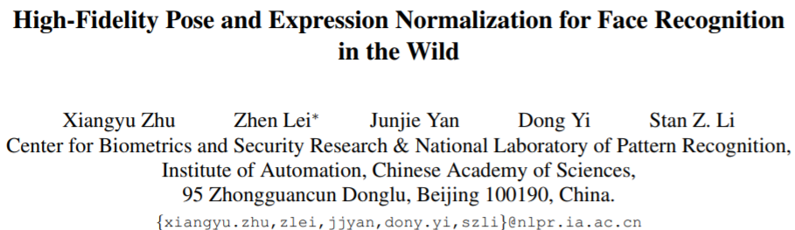
Proposed method
Obtaining the ground truth:
The dataset we used contains manually annotated facial landmarks, therefore the fitting of the template face to the images can be achieved by estimating the coordinate transformation for each vertex:

Slide 8
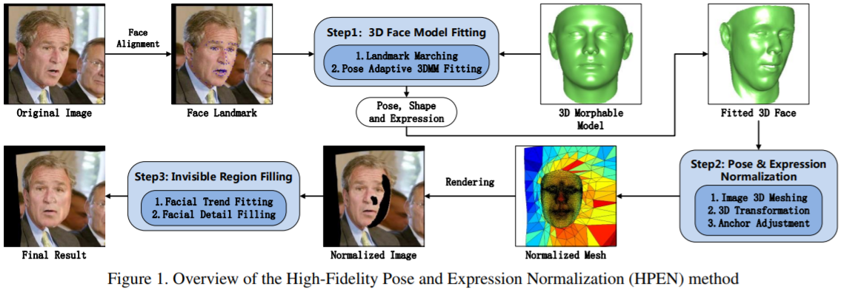
Proposed method
Obtaining the ground truth:
The dataset we used contains manually annotated facial landmarks, therefore the fitting of the template face to the images can be achieved by estimating the coordinate transformation for each vertex:

Slide 9
Proposed method
Purposes of Network:
Identify each pixel in the face while ignore non-face pixels;
Estimate coordinates in canonical face space for each face pixel.
Solution:
Use two module, one for identifying coarse face region, another for refining region-specific prediction for facial pixels’ U-V field.

Slide 10
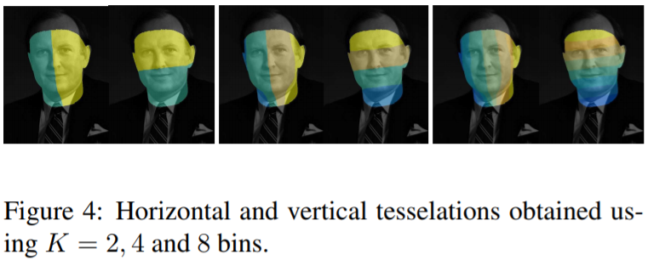
Proposed method
Network structure:
To quantize the given face to U-V map, we tessellate the template face with a Cartesian grid, and uniformly quantize the U and V coordinates into K bins (labels), thus a classification CNN can be used to predict these bins.
Horizontal and vertical coordinates are predicted individually.

Slide 11
Proposed method
Network structure: (only horizontal is shown)
In the obtained ground truth, every position x is associated with a scalar value u in UV space. Rather than predicting u directly, we transform it into a pair of discrete q (quantization) and continuous r (residual):

Slide 12
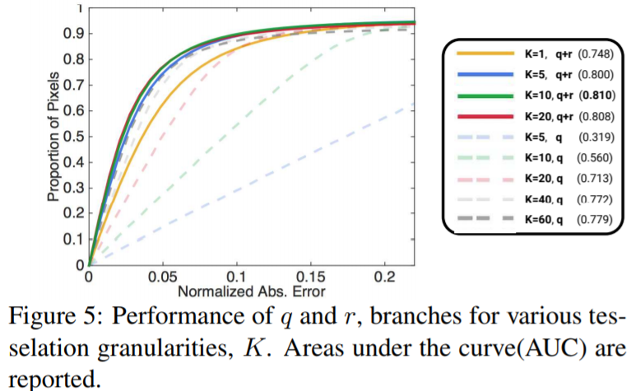
Proposed method
Network structure: (only horizontal is shown)

Slide 13
Experiment result
Training dataset: 3DDFA for existing ground truth, LFPW, HELEN, and AFW for faces in unconstrained conditions, pre-processed by DPM face detector.
CNN fine-tuning: adopt ResNet101 architecture with dilated convolution, with smooth L1 loss layers. The network is pre-trained by MS COCO dataset.
Code available at: github.com/ralpguler/DenseReg

Slide 14
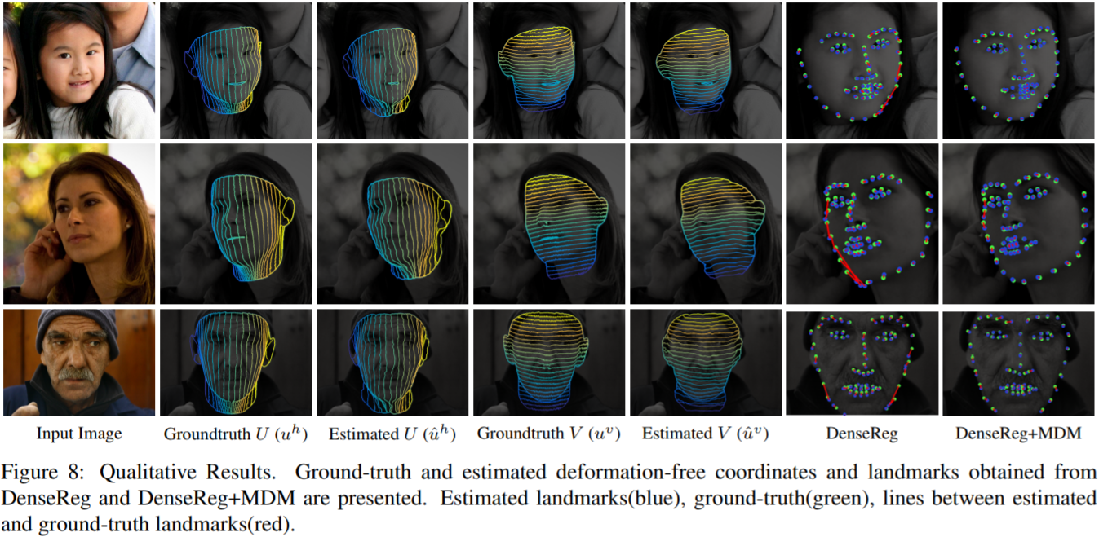
Experiment result
Qualitative results:

Slide 15
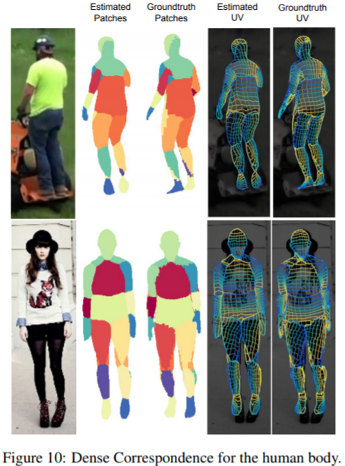
Experiment result
Transfer to human body representation:
Use “Unite the People” dataset for training and testing;
Replace quantization net with partition net, the rest of the system remains the same;
test the performance only in visual consistence (no dense correspondence available).

